Slide 1
AQE Training Evaluation
Aniket Khartade

Slide 2
Project Flow
2
4
Github
Docker
Version control
Comman environment
1
3
Springboot
Jenkins
Working on spring boot project
Automate CI/CD pipeline

Slide 3
01
Springboot application

Slide 4
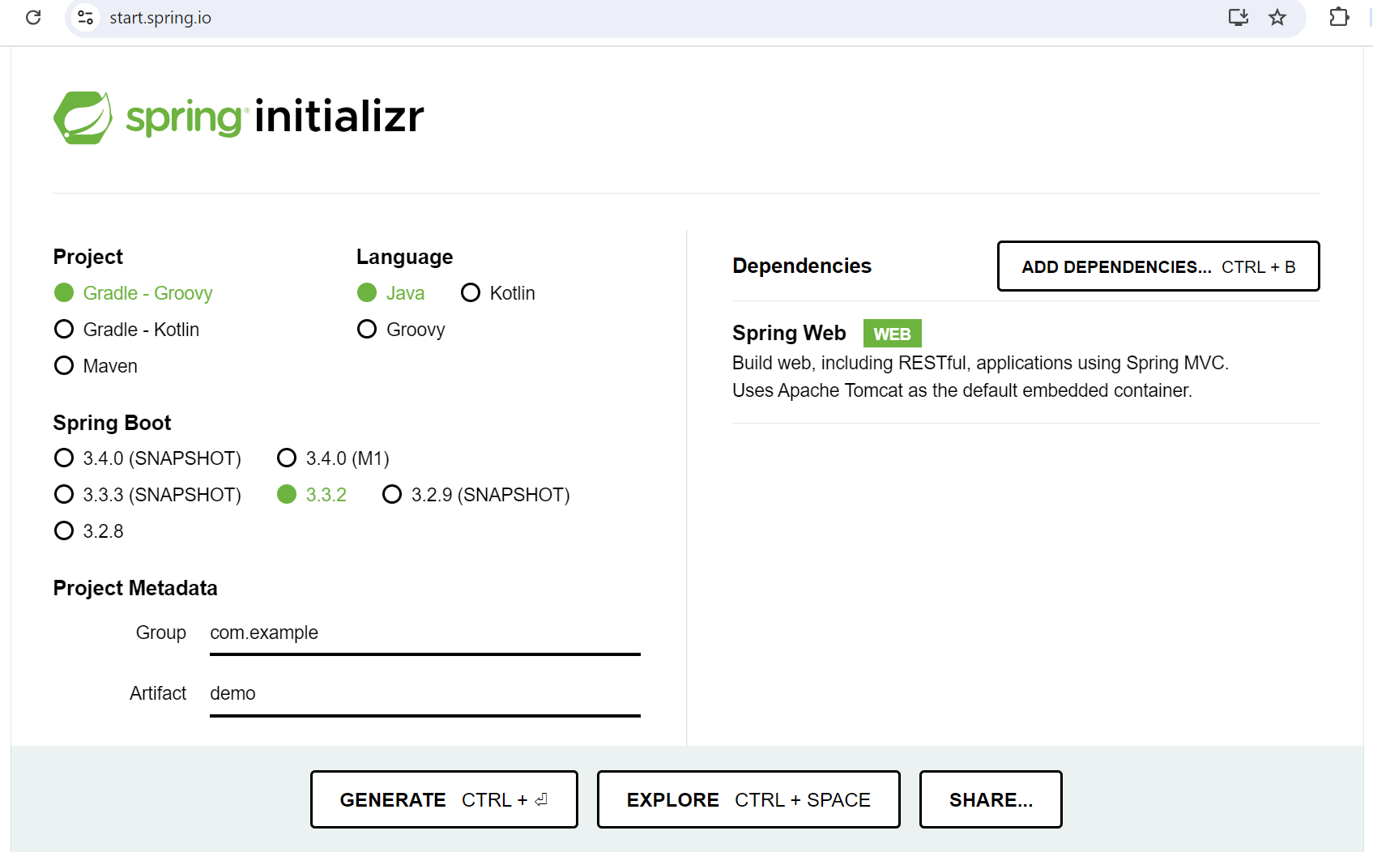
Steps for springboot
Spring initializr

Slide 5
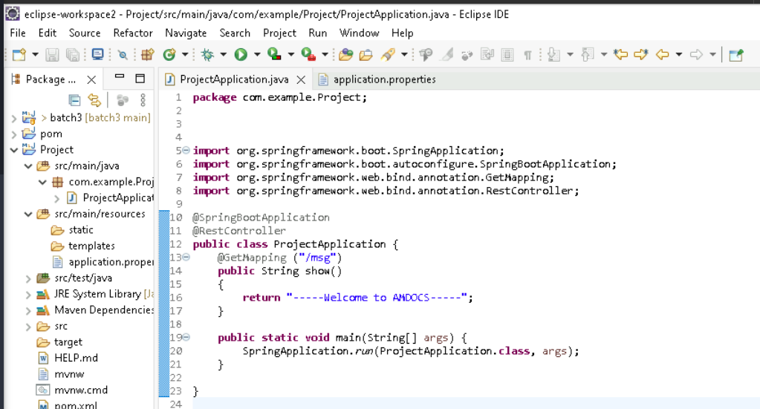
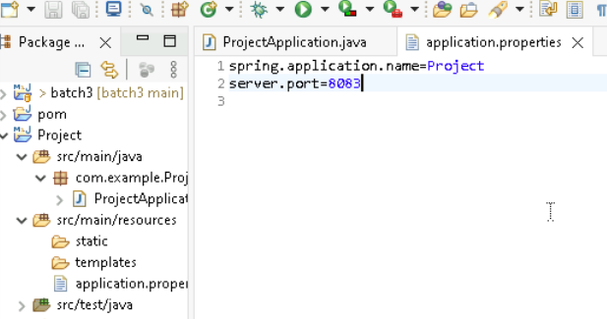
Steps for springboot
ProjectApplication.java
Application.properties

Slide 6
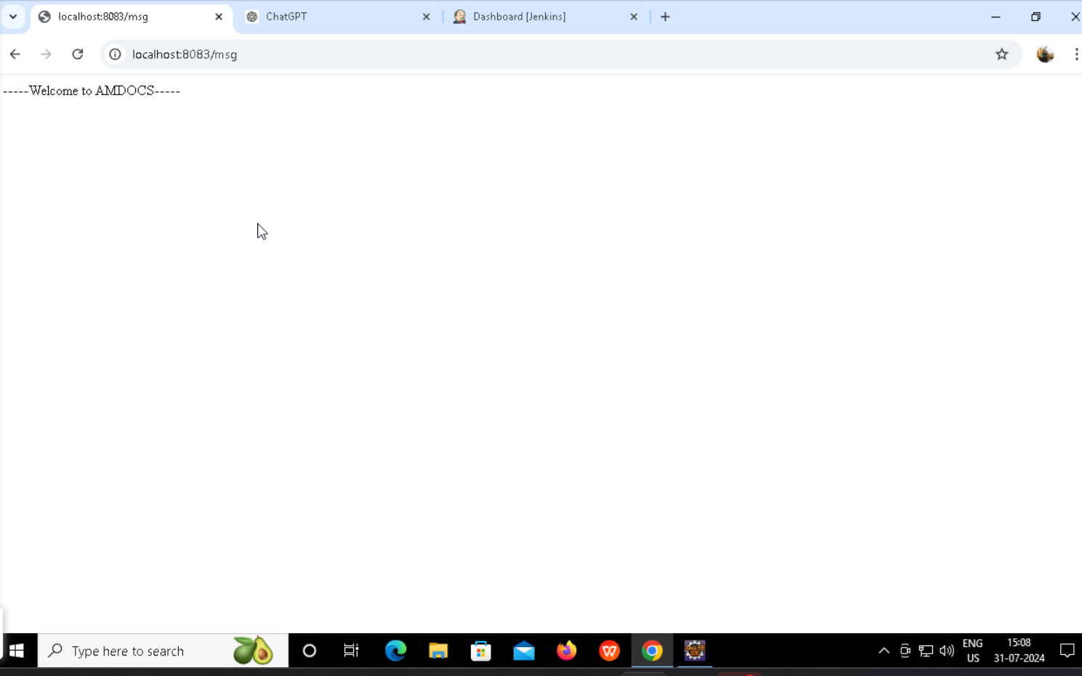
Output for springboot
localhost:8083/msg

Slide 7
02
Github
Version control

Slide 8
Steps to push project on github
git init
git add .
git commit –m “message”
git remote add origin https://github.com/Aniket-rk123/jenkin.git
git branch –m main
git push –u origin main

Slide 9
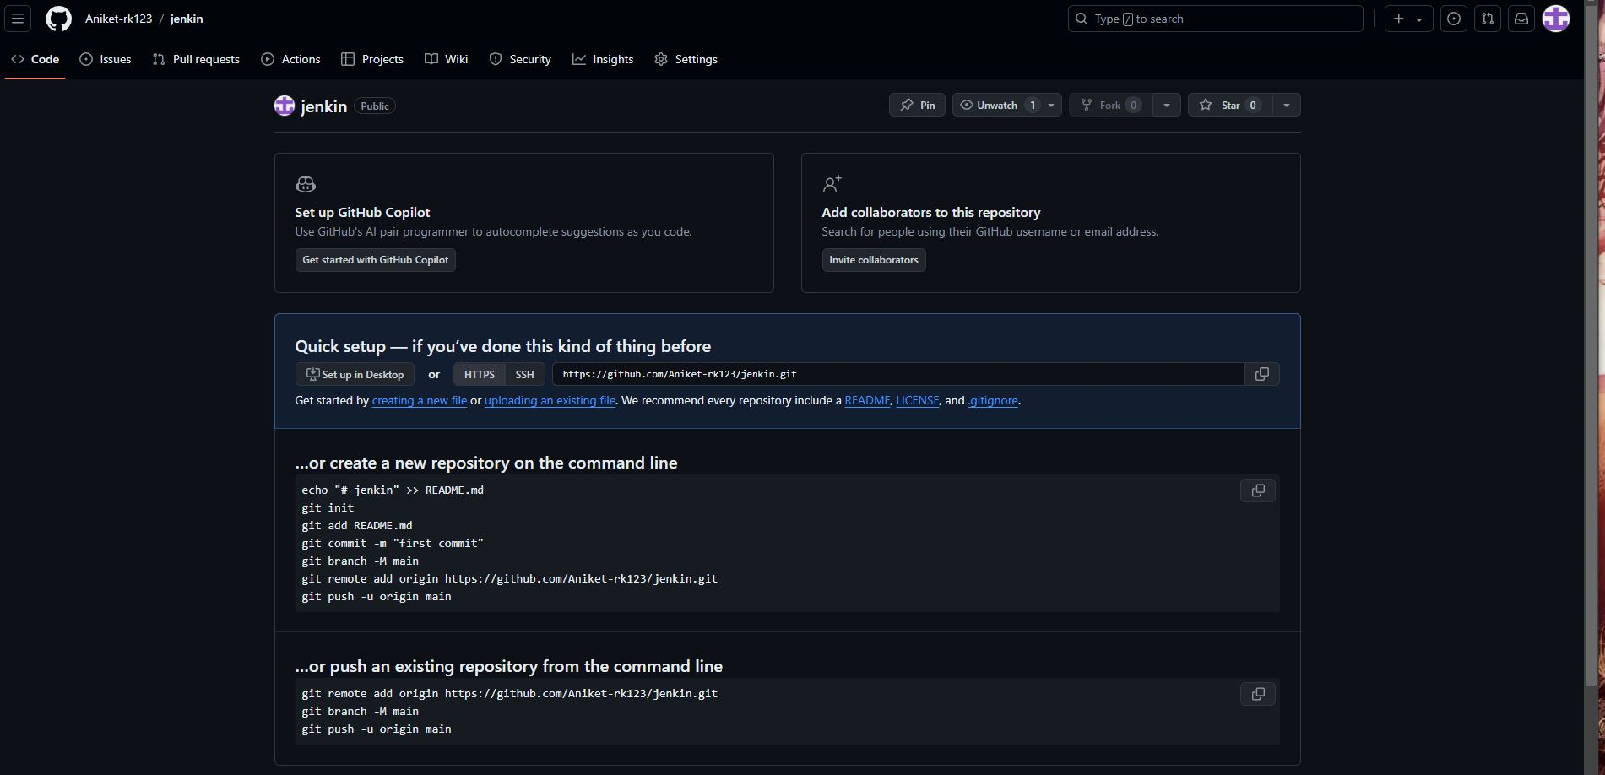
Output of git commands

Slide 10
03
Jenkins
Open source server to automate deployment

Slide 11
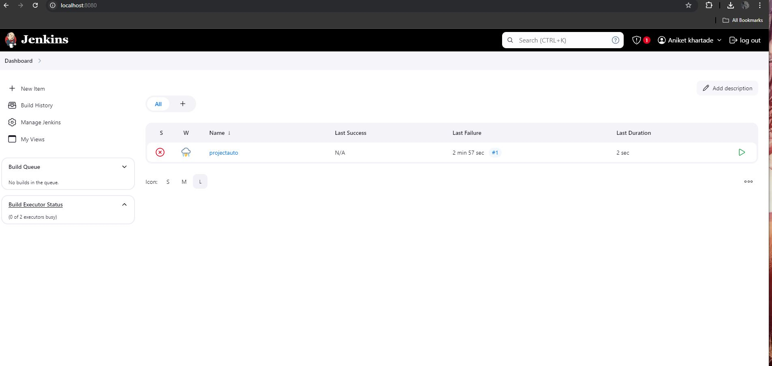
Output of Jenkins

Slide 12
04
Docker hub

Slide 13
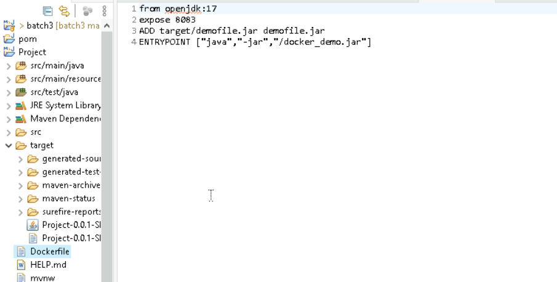
Dockerizing the project
Contents in Dockerfile

Slide 14
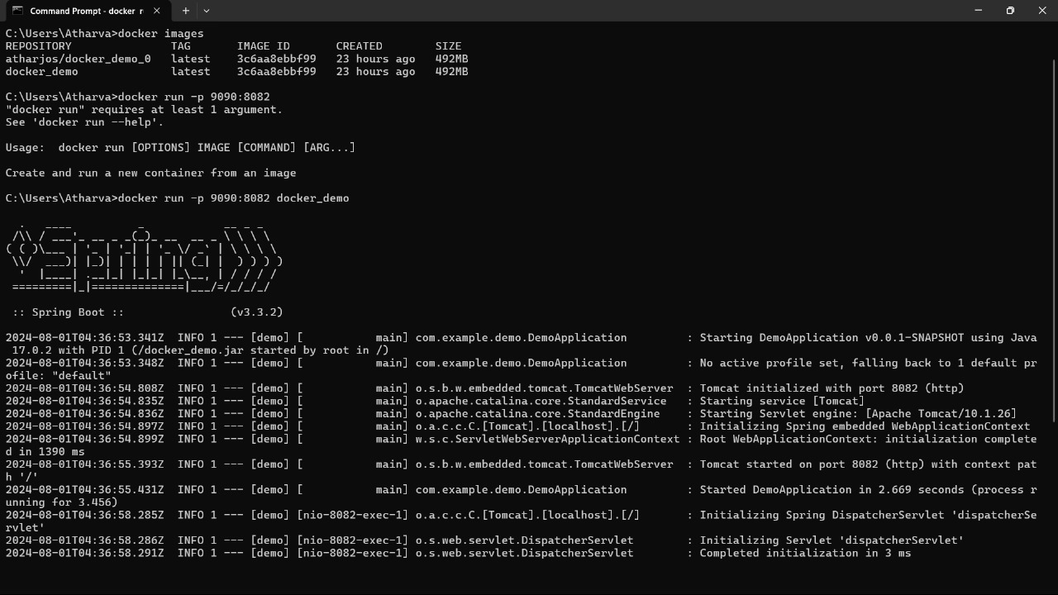
Dockerizing the project
Commands used to dockerize the project
Docker –version
Docker images
Docker build –t project_name
Docker run –p 9090:8083 project_name
Docker tag project_name
Docker pull img_name

Slide 15
05
Testing a demo Website

Slide 16
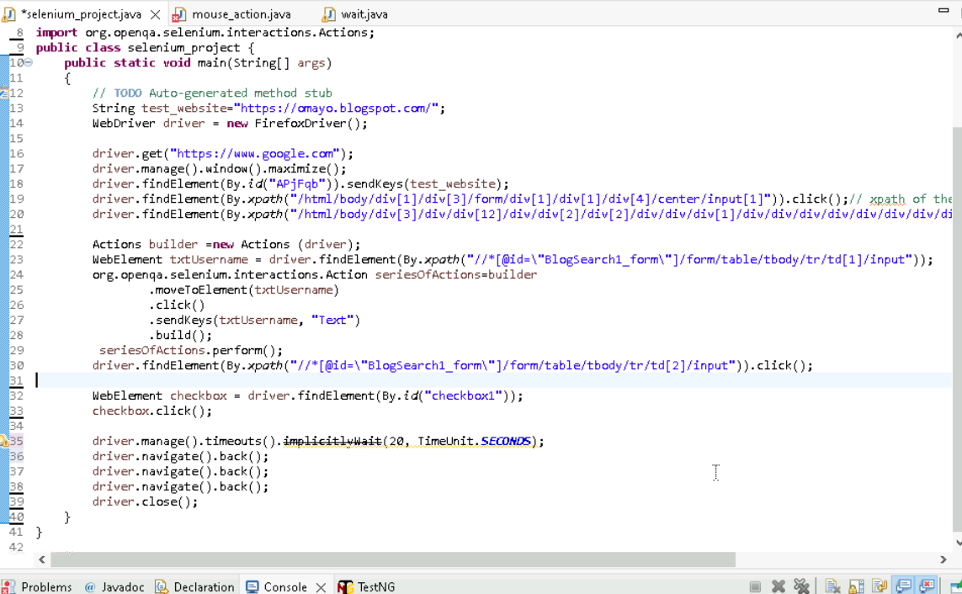
Code for testing

Slide 17
Potential Issues:
Hardcoded values: The script uses hardcoded values for the website URL, element locators, and text input. This makes it less flexible and maintainable.
XPath dependency: Extensive use of XPath for element locating can be fragile and prone to errors. Consider using more robust locators like ID or CSS selectors when possible.
Lack of error handling: The code doesn't include any error handling mechanisms, which can lead to unexpected behavior in case of exceptions.
Test case structure: The code lacks proper test case structure and organization, making it difficult to maintain and extend.
Improvements:
Use parameterized values for website URL, element locators, and text input.
Explore alternative locators like ID or CSS selectors.
Implement proper error handling using try-catch blocks.
Structure the code into separate methods for better readability and reusability.

Slide 18
Conclusion
Thus we have successfully
Created a project using sprinboot
Pushed the project on github
Used Jenkins for CI/CD pipeline
Docarize the project
Tested a demo website

Slide 19
Thanks!
Do you have any questions?

